Slide 1


Answer the call. Build solutions that fight back.
In a very short period of time, COVID-19 has brought modern life to a screeching halt, disrupting our healthcare, education and economic systems. But we can fight back – with technology. The 2020 Call for Code Global Challenge has expanded to take on COVID-19 in addition to climate change. Created by David Clark Cause with Founding Partner IBM, and in partnership with the United Nations Human Rights and The Linux Foundation, Call for Code is the largest tech-for-good challenge of its kind. Innovators and problem solvers: join us to create open source solutions that make an immediate and lasting impact. Now, more than ever, is the time to use technology for good.
callforcode.org

Slide 2


Call for Code. Next Steps
Debjani Chatterjee
-Developer Advocate(Communities)
Notes:
Hello everyone and welcome to the webcast. My name is Debjani and I'm a developer advocate for IBM handing Bangalore and around.

Slide 3
Agenda
What is Call for Code? – Recap
What’s new and COVID-19
What are the next steps
How to submit to the Global Challenge
QnA
DevRel / CFC-India / April 10, 2020 / © 2020 IBM Corporation
Notes:
Today, I be will taking you through a recap of Call for code. With COVID-19 there have been a few changes to the global challenge, so we will cover those. I will then take you through the submission process.
followed by a QnA. Please note that the QnA will be on Slack, please join the slack workspace.

Slide 4
Are you on Slack Yet? bit.ly/ibm-dev #cfc-india
Notes:
A few guidelines before I begin,
I will urge each once of you to refrain from using the webex chat since we will not be monitoring it and will be using it to post any important messages or links during the sessions.
Please use the channel you see on the screen to post your questions and we will be helping you guys to sort out any problems. Please do use the #ibm-account-issues-only channel to post issues with account creation.
Lastly, a recorded version of this webinar will be available along with workshop details will be mailed to you.

Slide 5
The reality
Notes:
So call for code always takes on the large humanitarian challenges that the world faces and provides a way to match technology against those issues.

Slide 6

“We are at a critical point in the global response to COVID-19 – we need everyone to get involved in this massive effort to keep the world safe.”
Dr. Tedros Adhanom Ghebreyesus
WHO Director-General
“…the disease that is ravaging our world.”
-UN News
“…now threatening all of humankind.”
-UN News
“…the true fight of our lives.”
-UN News
Notes:
So as you know, this year we have got two tracks in it, one of which is creating tactical applications that can impact the global pandemic COVID-19. It is not about doing scientific research or vaccine development or folding proteins but this is around addressing other issues that impact the society.
But with the global pandemic of the corona virus, Call for Code has been expanded this year to contain dual tracks that address the world’s reaction to COVID-19 in addition to Climate Change —these are two pressing issues that have the power to compromise our health, our planet, and our survival, with thousands of people dying in every country and a steep rise in the number of active cases in India even with the whole country under lockdown is extremely alarming.
We are social distancing, food and only necessary resources are available to a privileged few of us, while the govt is working tirelessly to reach food to the financially affected daily wage workers.
In times like these crisis, communication can take a major hit, think of ways to reach the mass with technology.

Slide 7
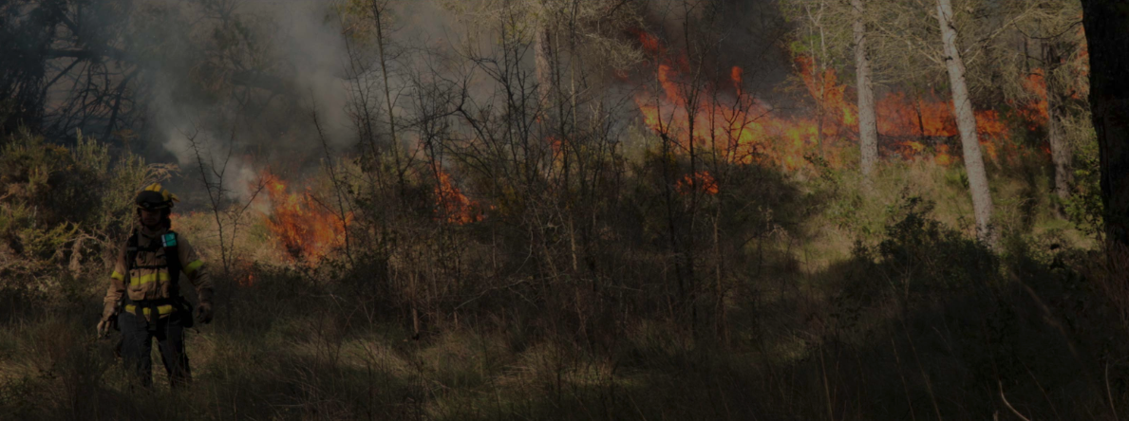
“The climate crisis is caused by us - and the solutions must come from us. We have the tools: technology is on our side.”
António Guterres Secretary-General of the United Nations
*Background image: 2019 Call for Code Winner Prometeo’s field test, Barcelona, Spain, February 2020
75%
of earth’s carbon emissions are caused by our cities .
1/4
of people are likely to live in chronic water shortage areas by 2050.
37m people are severely effected by natural disasters every year.
Notes:
When we launched cfc in feb we originally had focused on climate change, as the big issue that we wanted you folks to tackle.

Slide 8
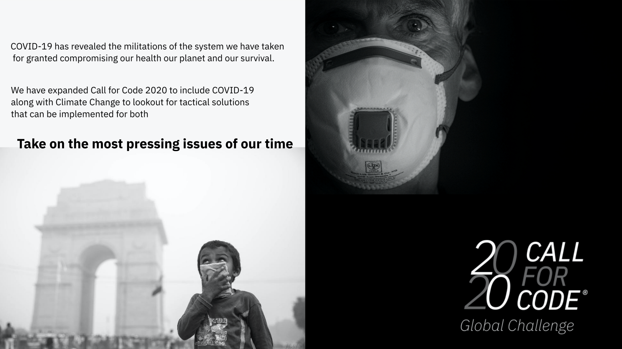
Notes:
In both cases we are looking for applications submitted to um build on ideas that take out a piece of scope that can be solved by technology, ones that we can support and help deploy through applications that you build on IBM Cloud and the services.
When you look at a large issue like COVID19 and Climate change,

Slide 9
What the world needs to fight Climate Change
Notes:
When you look at large issues like COVID 19 and Climate change it can be very difficult to understand as to how you can translate large issues into solutions, into something that you can work on and go on implementing those, what you can do today to make a difference.

Slide 10

Water sustainability
Energy sustainability
Disaster resiliency
2B+
People are living with risk of
reduced access to freshwater resources
60%
Total greenhouse gas emissions are due to current energy methodologies
1M
People have died because of natural disasters since the turn of the century
Notes:
If you see the previous years call for code you will see that we have focused on natural disasters and it is still a key issue and tied to climate change
So when you look at the sub parts in this track, water and energy sustainability and disaster resiliency becomes a part.

Slide 11
What the world needs to fight COVID-19
Notes:
So with COVID 19
Again we are not asking or looking for any scientific research, producing vaccines, but in what other ways can you help tackle the situation better. To track perhaps or to connect.

Slide 12

Crisis Communication
Remote Education
Community Cooperation
When a new disease emerges, communications systems are one of the first systems to be overwhelmed
School closures & social distancing is leaving students at home for an indeterminate amount of time
Understanding what is happening in your neighborhood & how you can give & get help is vital in uncertain times
Notes:
Hence we have crisis communication, how do you deal with automating communication between workers maybe for resource distribution, connecting with local authorities or businesses.
The rest of the world is getting up online, today you guys have connected with us, but there are many who do not have access, how do you ensure continued education for those so that they are not disconnected.
And finally community cooperation, how do you connect with your neighbours with social distancing, we do have a few tools, video calls, whatsapp and all of that.

Slide 13
What action can you take now?
Notes:
Now, as you know we will be helping you out to create these solutions for the hackathon that you will be submitting in this hackathon.
Once you have the India challenge through, you can submit your solutions to the global challenge irrespective of your position in this hackathon.

Slide 14
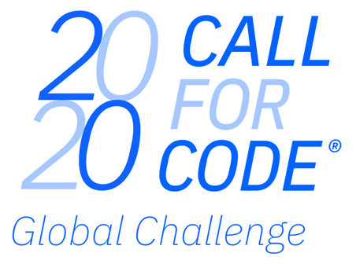



Build solutions that fight back.
Build & deploy solutions to help seize & reduce the impact of COVID-19
Build & deploy solutions to help halt & reverse the impact of Climate Change
In 2020, Call for Code is aligned to the UN 75th anniversary global conversation theme of climate change, with a focus on:
water sustainability
energy sustainability
disaster resiliency
The 2020 Call for Code Global Challenge is being expanded to address the COVID-19 pandemic, with a focus on:
crisis communication
remote education
community cooperation
Join a movement of:
210,000+ problem solvers
165+ nations
8,000+ applications built
Have the chance to win:
$200,000 USD
Open Source support from The Linux Foundation
Meetings with mentors & potential investors
Implementation support through Code and Response™
Call for Code Founding Partner
Call for Code Creator
Call for Code Charitable Partner
Call for Code Affiliate
Notes:
Now you may ask why should I, well obviously there is cash prize and loads of other benefits that come with it in the global challenge.
We also have regional level winners and last year we had Purva-Suchak, a team of developers from Cognizant Pune who won a prize money of 5K dollars, they provided a potential solution to prevent flooding which is a common phenomenon every monsoon in India.
The winning team and four runners up will receive support from The Linux Foundation to nurture their submission as an Apache 2 Licensed open source project and build a community around it, ensuring that it is freely deployable around the world in the areas of greatest need. The Participation Agreement contains complete details of the rules.

Slide 15
Previous Call for Code winners
Call for Code 2019 Winner, Prometeo
A first of its kind, hardware-software solution equipped with sensors that detect toxicity levels for firefighters battling wildfires in real time, offering a transformative solution to first-responders globally
Technology: IBM Cloud IoT Platform, IBM Cloud services, Cloudant database
https://www.youtube.com/watch?v=iPI9NJkXLuA
Notes:
In the call for code 2019 challenge, the Prometeo team developed a first of its kind, hardware-software solution equipped with sensors that detect toxicity levels for firefighters battling wildfires in real time, offering a transformative solution to first-responders globally. And in 2018, the Project Owl team created a groundbreaking hardware-software solution that automatically constructs a mesh network via small Wi-Fi units allowing for sustained communications in peak times of need. Both winning teams received the $200,000 award, among with the others winnings previously mentioned. These teams answered the call

Slide 16
Previous Call for Code winners
Call for Code 2018 Winner, Project Owl
A groundbreaking hardware-software solution that automatically constructs a mesh network via small Wi-Fi units allowing for sustained communications in peak times of need
Technology: IBM Watson Studio, IBM Cloud IoT Platform
https://www.youtube.com/watch?v=lc4amiOIy9A
Notes:
Project OWL, an IoT and software solution that keeps first responders and victims connected in a natural disaster, has won the 2018 Call for Code Global Challenge.
The team addresses a fundamental question that arises in the wake of a natural disaster: How do you maintain critical operations and communications when the power is cut and cell connectivity fails?

Slide 17

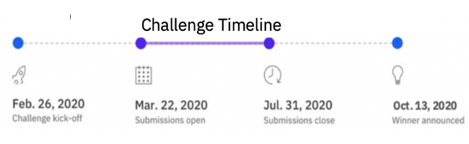

Build solutions that fight back.
Join a movement of:
210,000 developers, data scientists & problem solvers
165+ nations
8,000+ applications built in the prior 2 years
Help seize & reduce the impacts of the COVID-19 pandemic by addressing:
Crisis Communication
Remote Education
Community Cooperation
Help halt & reverse climate change by addressing:
Water sustainability
Energy sustainability
Disaster resiliency
Have the chance to be awarded:
$200,000 USD
Open Source support from The Linux Foundation
Meetings with mentors & potential investors
Solution implementation support through Code and Response™
Register for the challenge and start building
Important links :
Accept the challenge: https://developer.ibm.com/callforcode/
Covid-19 Starter Kits/timelines :
https://developer.ibm.com/callforcode/getstarted/covid-19/
Climate Change Starter Kits/timelines :
https://developer.ibm.com/callforcode/getstarted/climate-change/
↓

Slide 18
Common Guidelines(both tracks), Next Steps and our resources ..
We should leverage the available resources well to create our build & deployable solutions to help seize & reduce the impact of COVID-19 and Climate Change.
Mentoring
Learn. Create. Share
IBM Developer consists of code patterns, open source code, tutorials, tech talks, resources, learning series to accelerate. Climate Change, with a focus on:
water sustainability
energy sustainability
disaster resiliency
IBM Cloud Platform
Availability of 190+ unique services to help quickly start building your deployable solution. Register Here(Accept the Challenge) or if you already have one then Login here
Watson AI services
Weather Data
Analytics engine
Container platform
Mobile platform
Dedicated slack workspace to communicate with one another & collaborate with IBM Mentors. https://callforcode.org/slack
Mentoring & guidance throughout from IBMers from across technology domains.
COVID-19 pandemic, with a focus on:
crisis communication
remote education
community cooperation

Slide 19
Submission guidelines

Slide 20
QnA

Slide 21
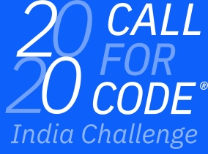


Join our Meetup groups
Bangalore: https://bit.ly/ibm-blr
Delhi and NCR: https://bit.ly/ibm-delhi
Mumbai: https://bit.ly/ibm-mumbai
Pune: https://bit.ly/ibm-pune
Hyderabad: https://bit.ly/ibm-hyd
Chennai: https://bit.ly/ibm-chennai
Courses and tutorials (earn badges)
https://cognitiveclass.ai
Check out the IBM Developer website
https://developer.ibm.com/
Code Patterns
Join the community on Slack
bit.ly/ibm-dev
Notes:
Let us quickly move on to taking a quick feedback from you guys and we will continue QnA future topics and more.
Cognitiveclass.ai is a free platform for learning
- where you can Earn badges and showcase on LinkedIn for your portfolio
- Expand your knowledge with courses for all skill levels
Developer.ibm.com
Is a repository of learning paths, tutorials, and open source projects. You have access to Code patterns which offer up complete solutions to problems that developers face every day. Code patterns leverage multiple technologies, products, or services to solve issues that our developer advocates have recognized as common use cases across multiple industries.

